Slide 1
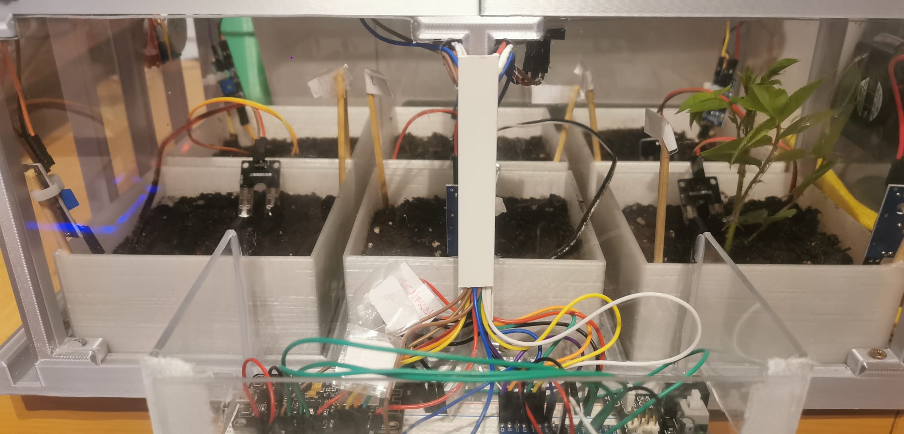

GreenHouse

Slide 2
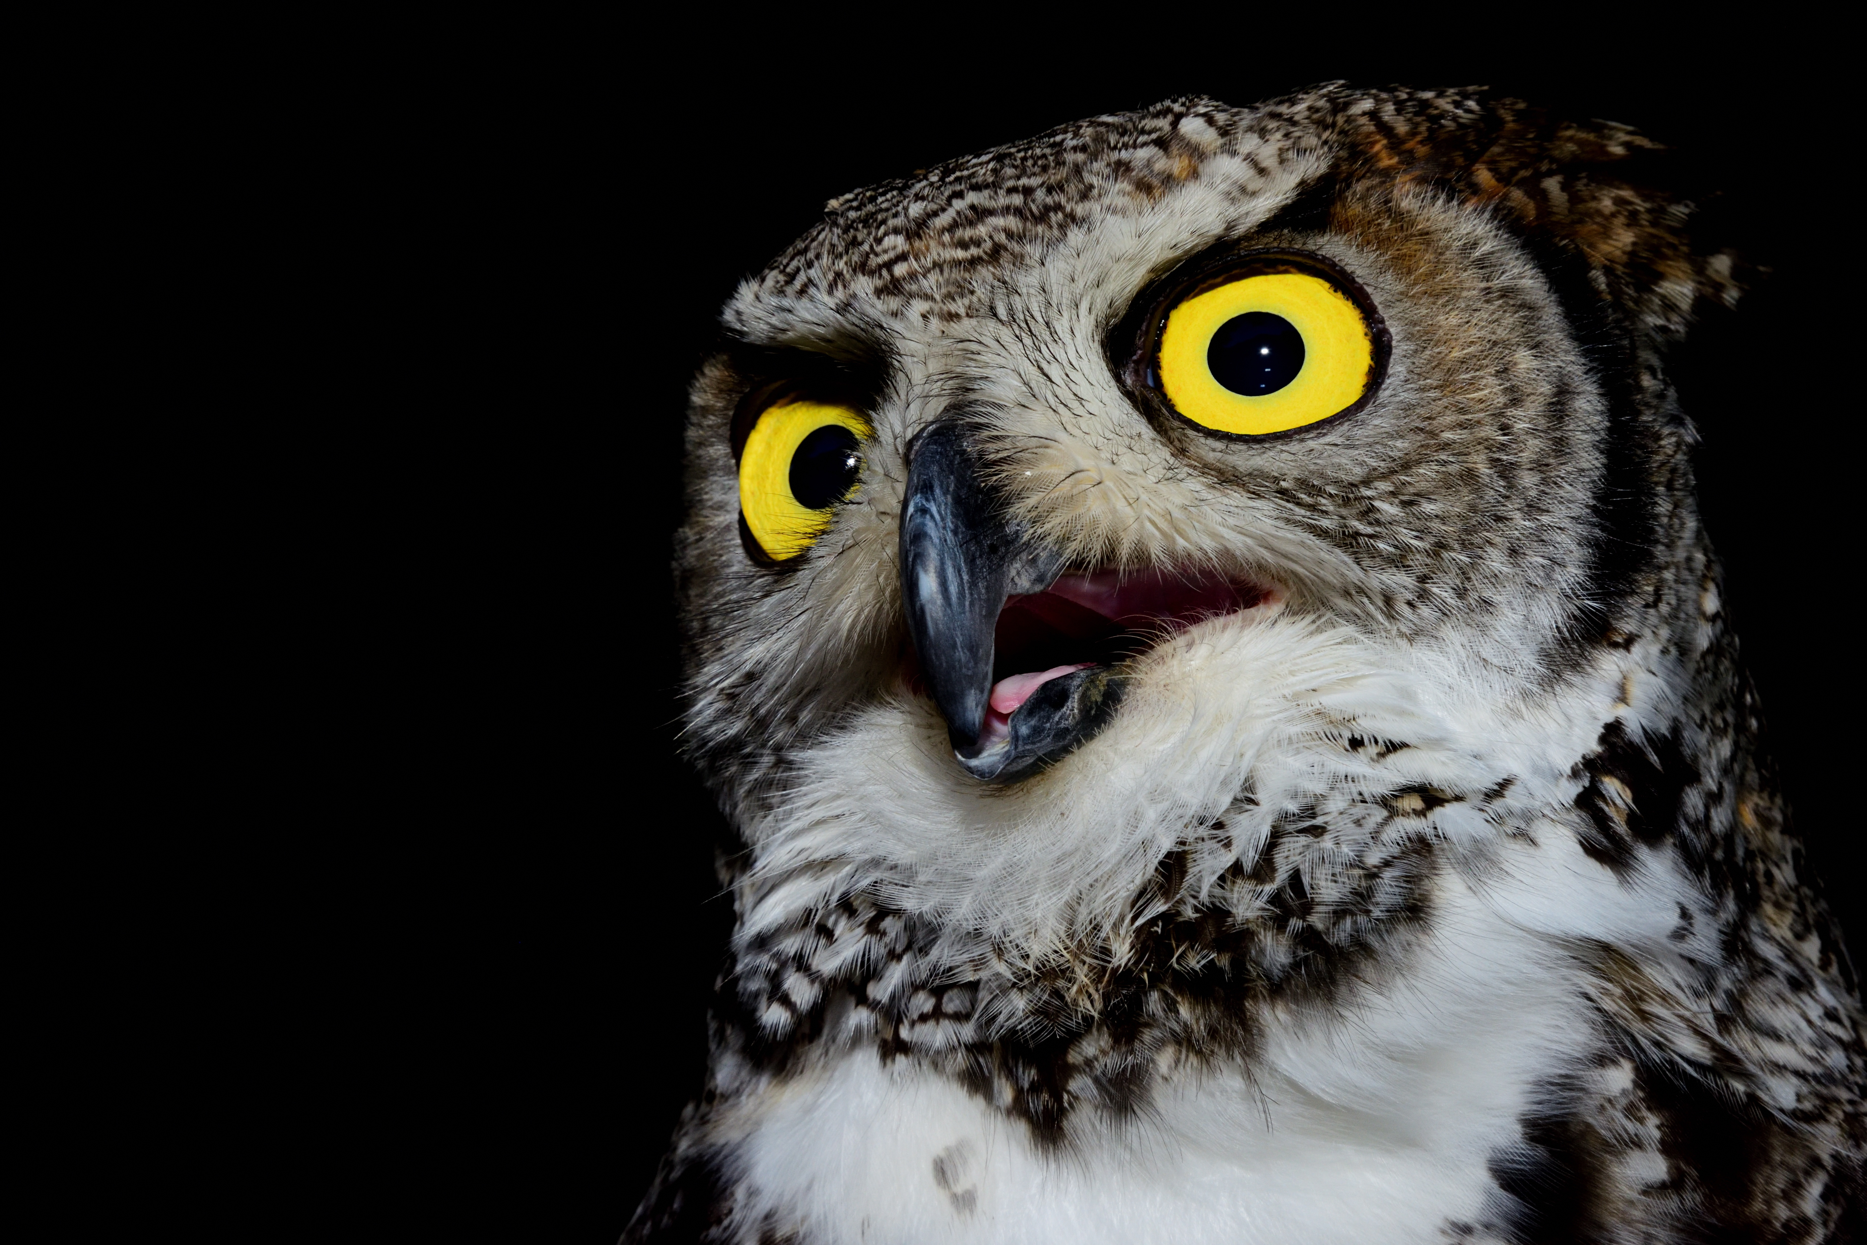
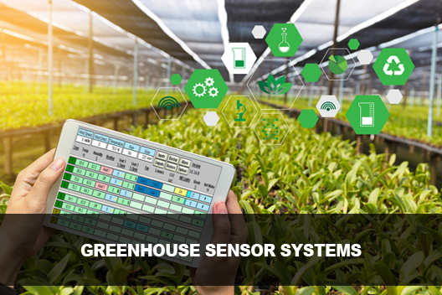

Main IDEA
The objective of this project was to design and implement an automated greenhouse system.
The aim of this system was to optimize the growth conditions for plants by utilizing sensors, actuators, and control algorithms.
8/05/2023 Launch Presentation

Slide 3
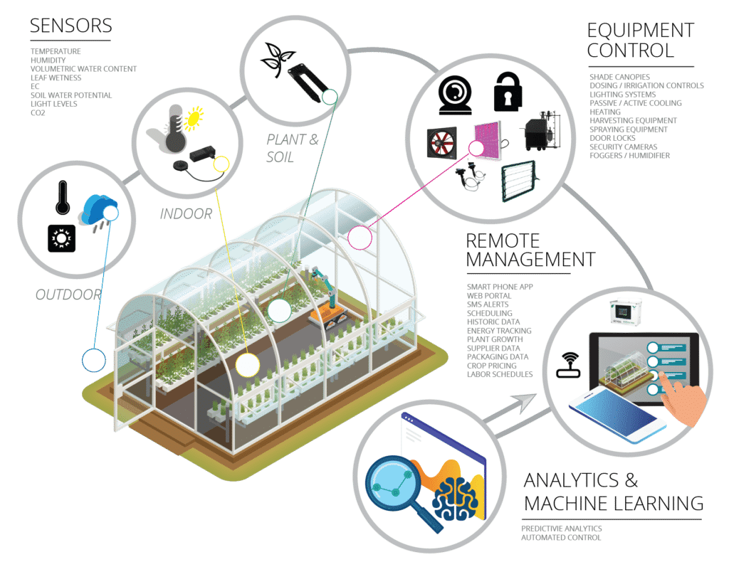

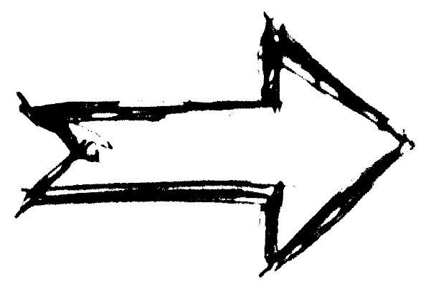
In Detail
- Sensors
Data
- Control
Autonomy
- Analytics
Data
- Actuators
8/05/2023 Launch Presentation

Slide 4
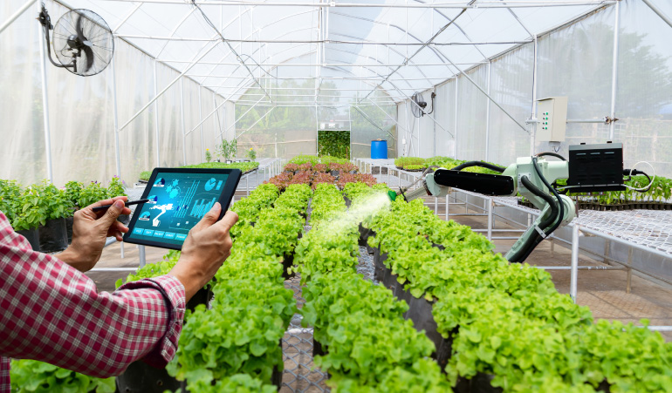
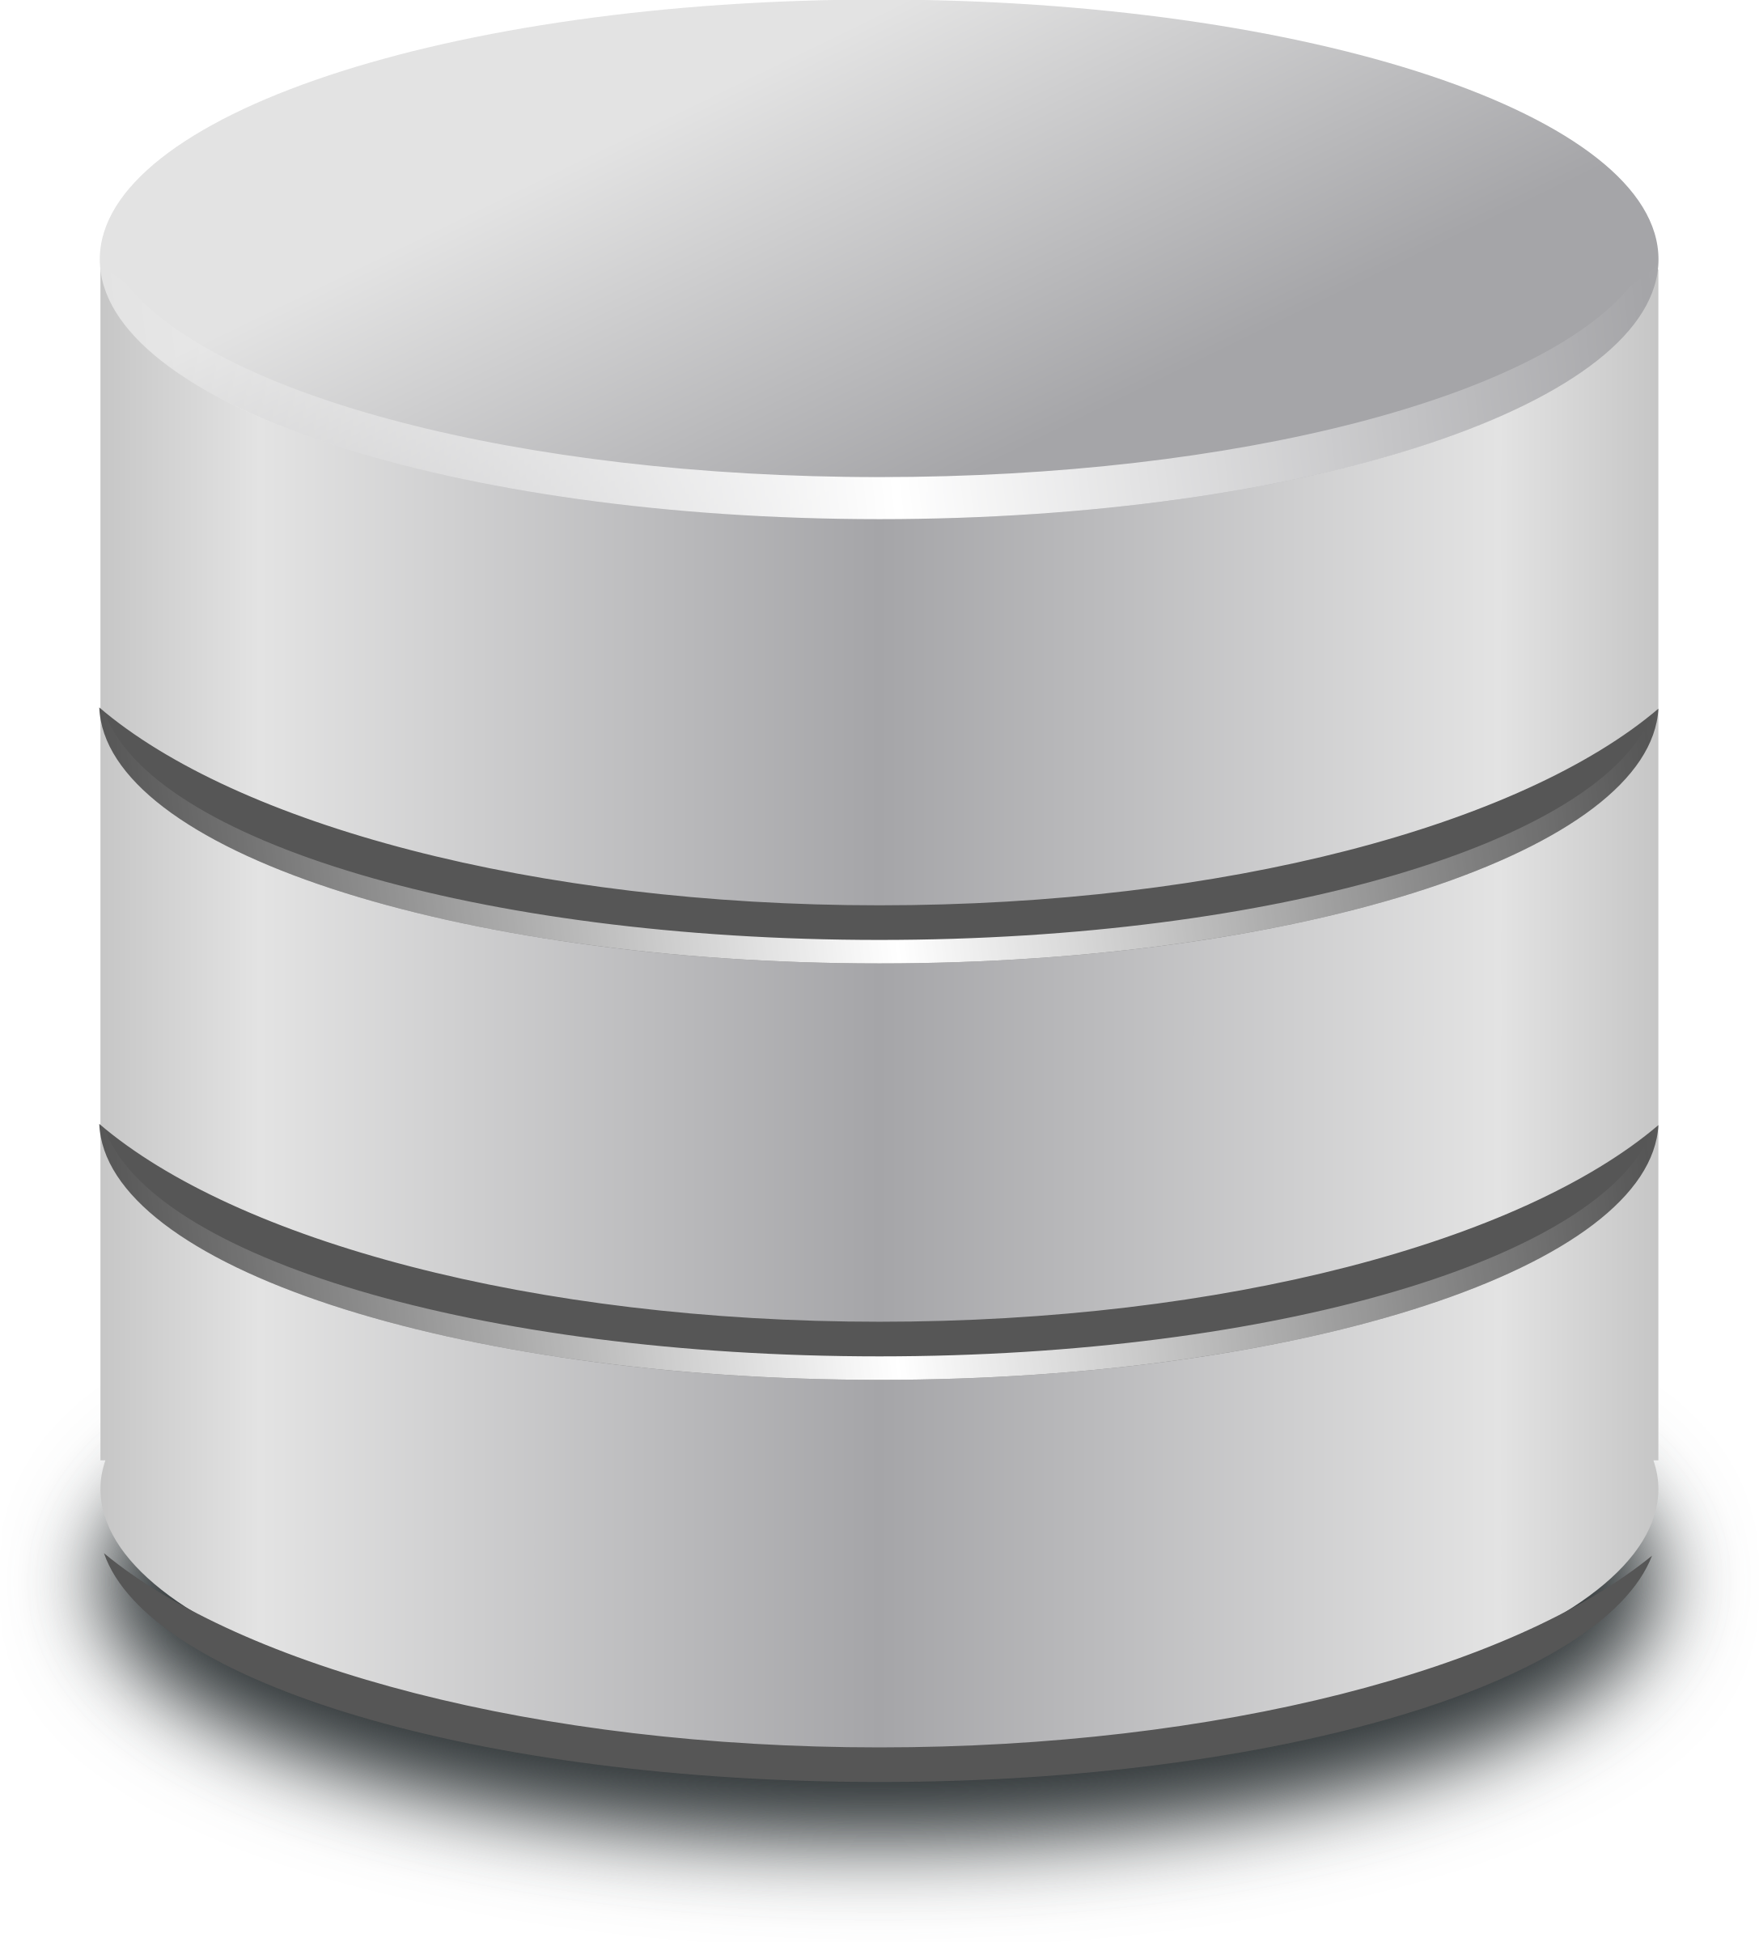
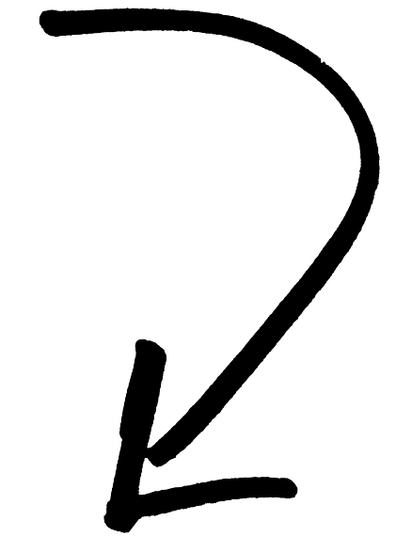
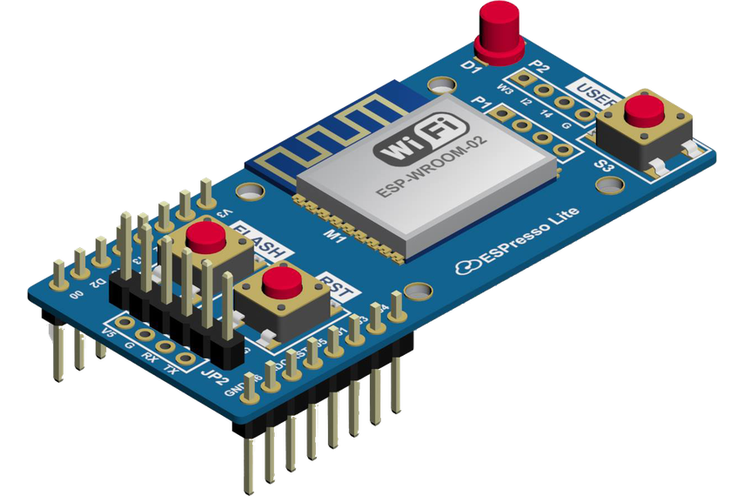
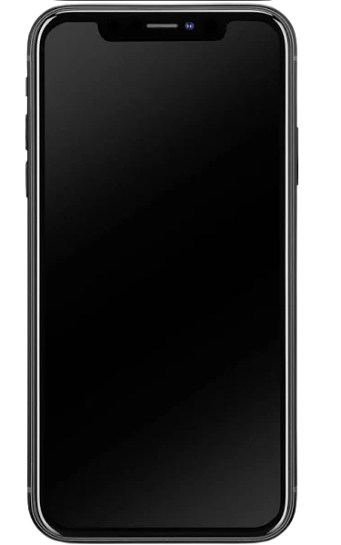
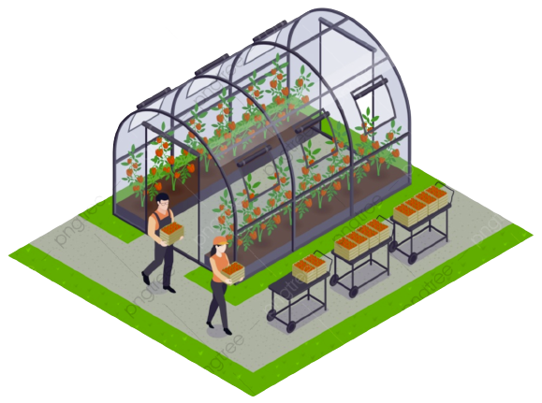

Product Overview
Manage Data
WORKFLOW
Control Center
NodeMCU acts as the interface between the sensors and actuators
Sensors collect data on the conditions inside the greenhouse and send it to the NodeMCU.
The NodeMCU then sends the data to Node-RED, which processes the information and can trigger certain actions based on predetermined conditions.
The processed data from Node-RED is then stored on AWS, where it can be analyzed and mined for valuable insights.
Data Storage
Collect Data
Report
Remote Management
8/05/2023 Launch Presentation

Slide 5
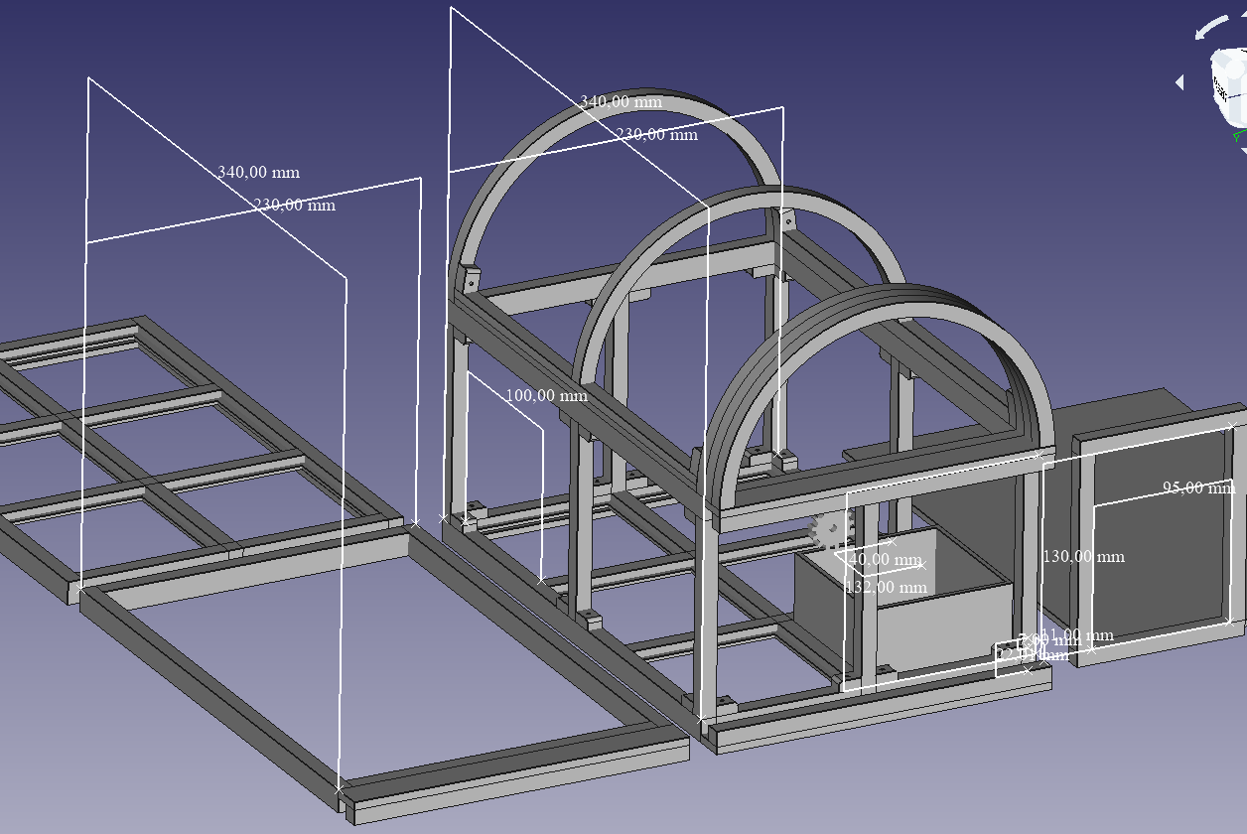
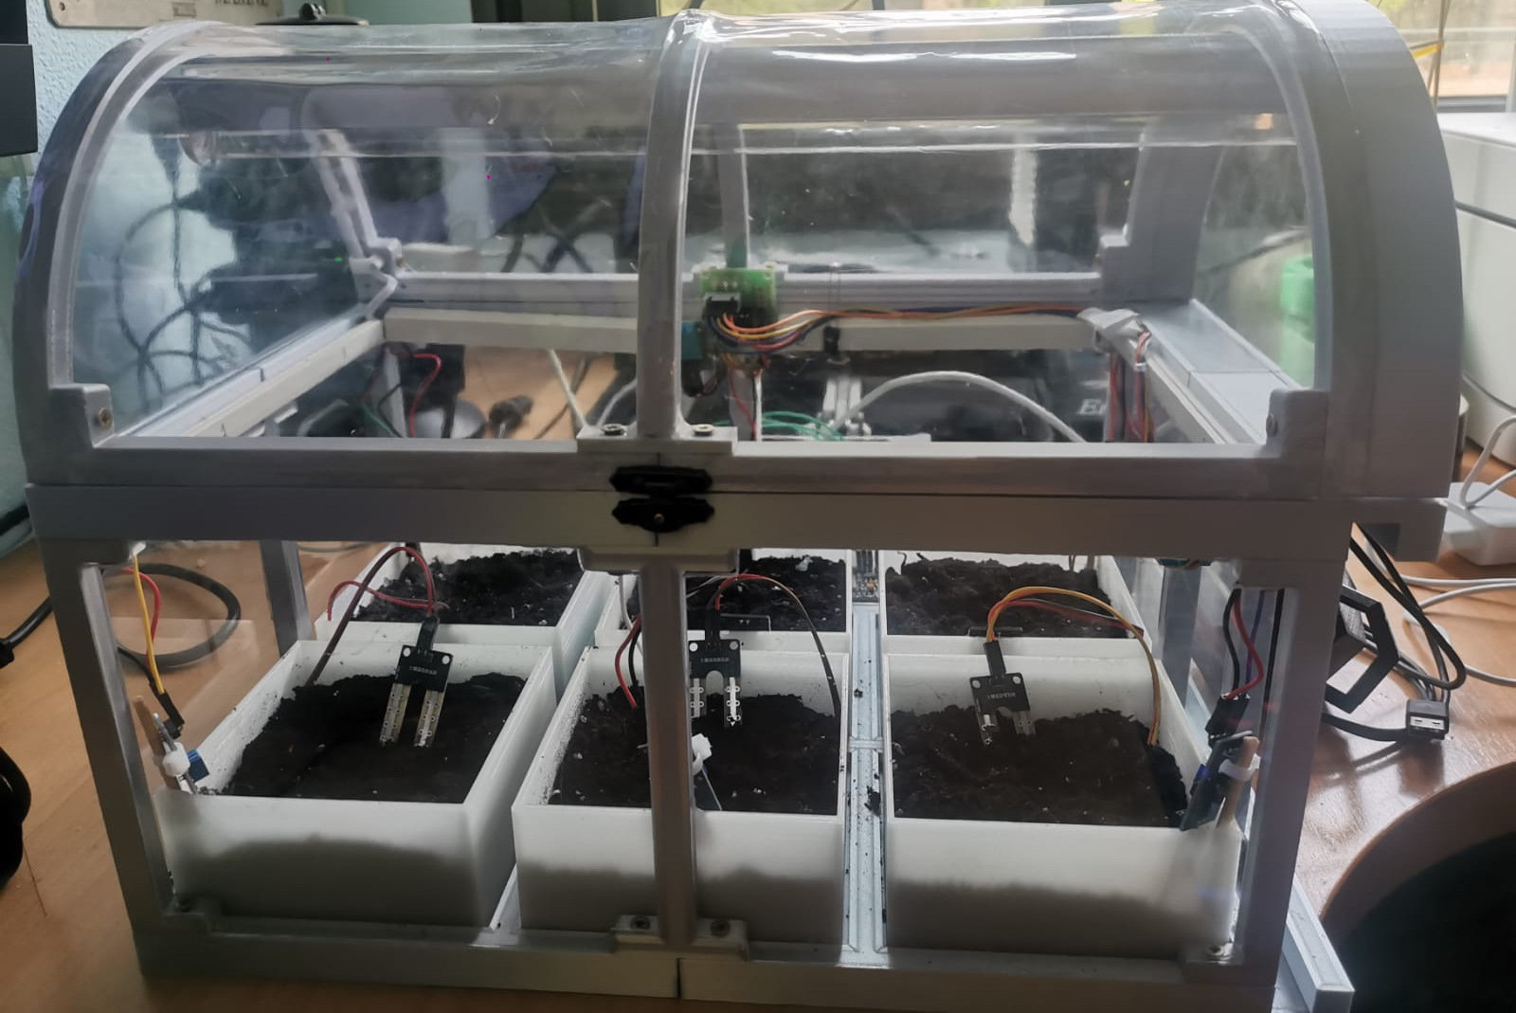
Building the mockup
Starting
Finished

Slide 6
HARDWARE

Slide 7
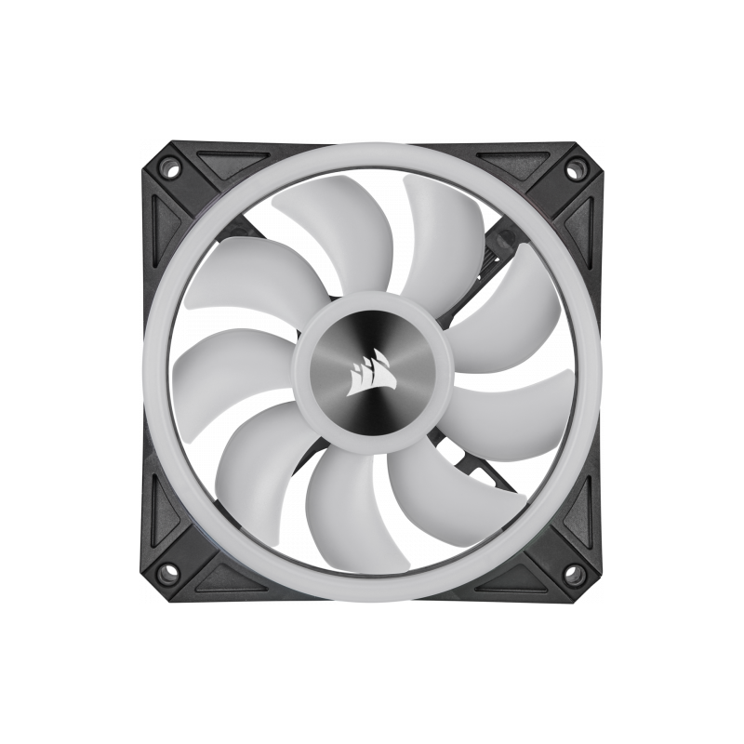
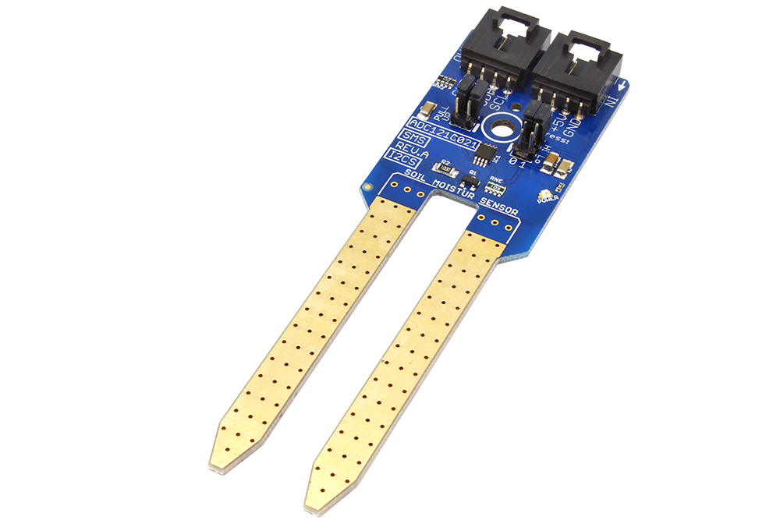
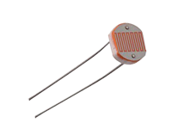
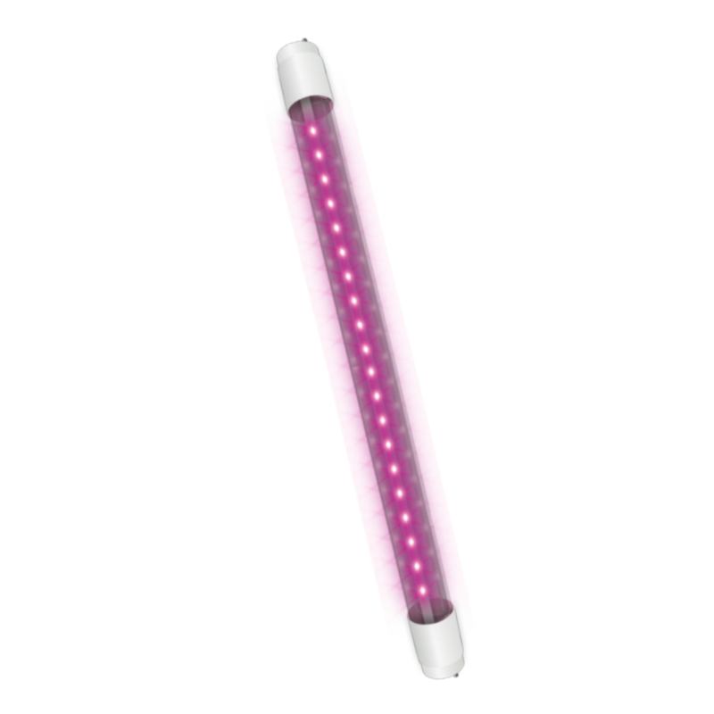
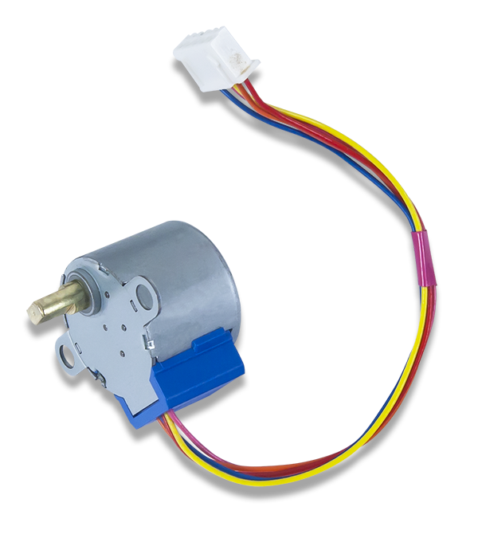
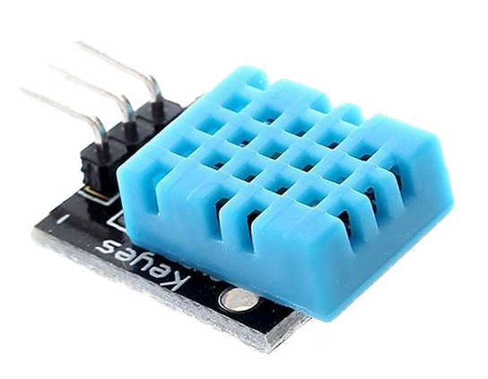
Sensors Actuators

Slide 8
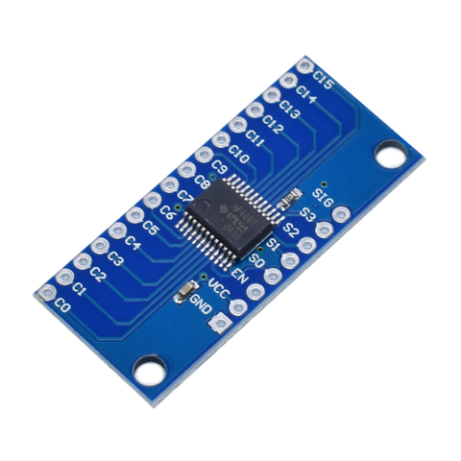
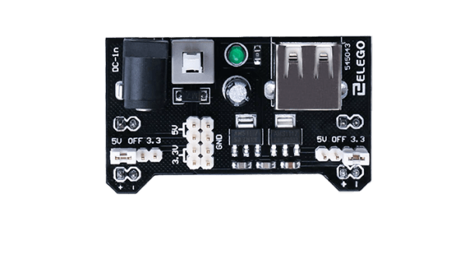
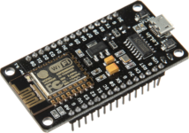
+hardware
NodeMCU ESP8266
Multiplexer
Power Supply Module

Slide 9
Software Implementation

Slide 10
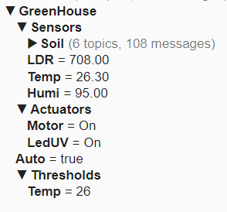
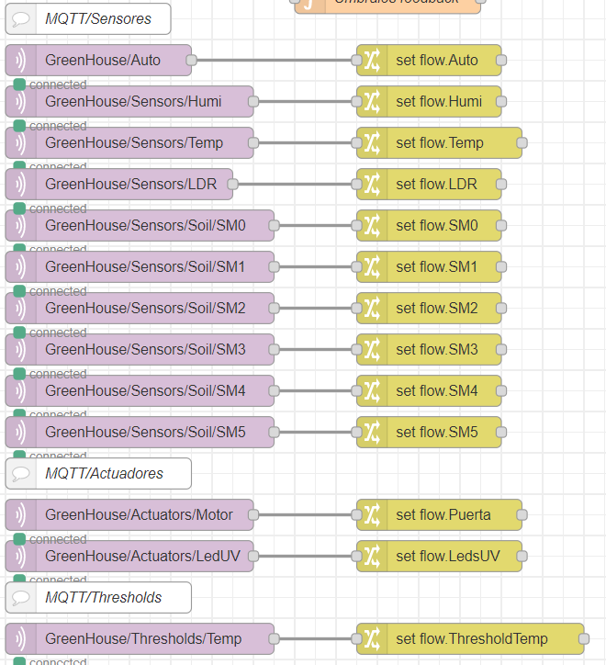
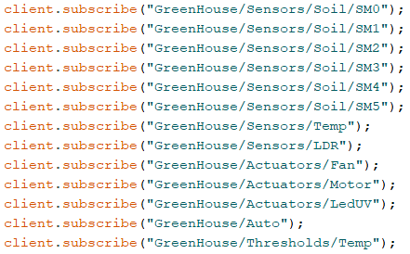
topics
Arduino
Node-RED

Slide 11
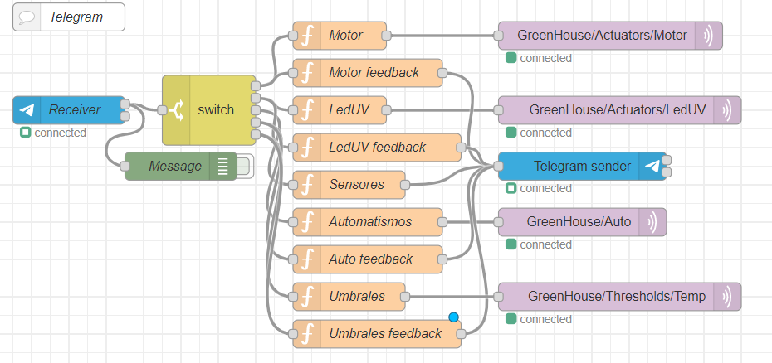
Node-RED

Slide 12
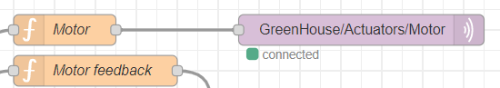
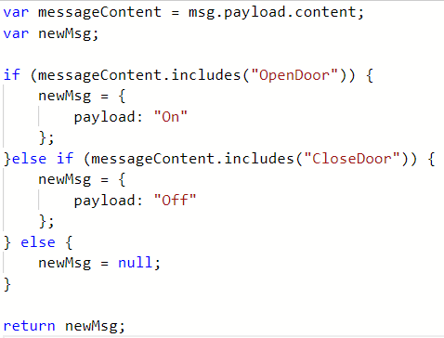
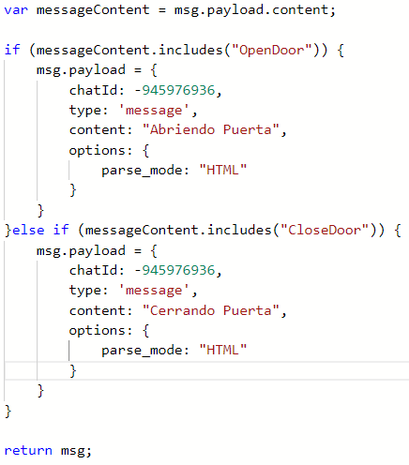
Motor
FEEDBACK

Slide 13
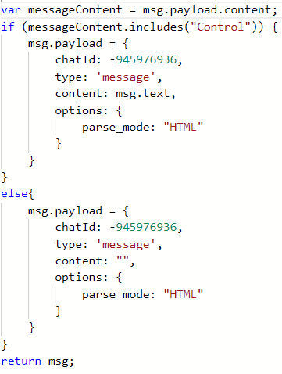
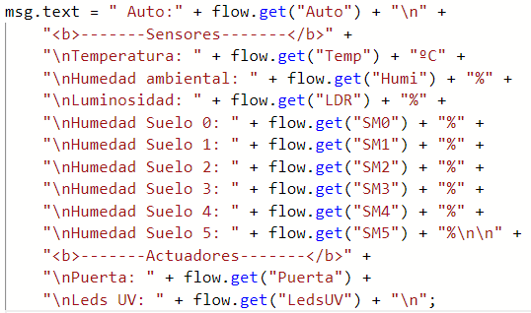
Sensors
Control message
Control information

Slide 14
demo

Slide 15

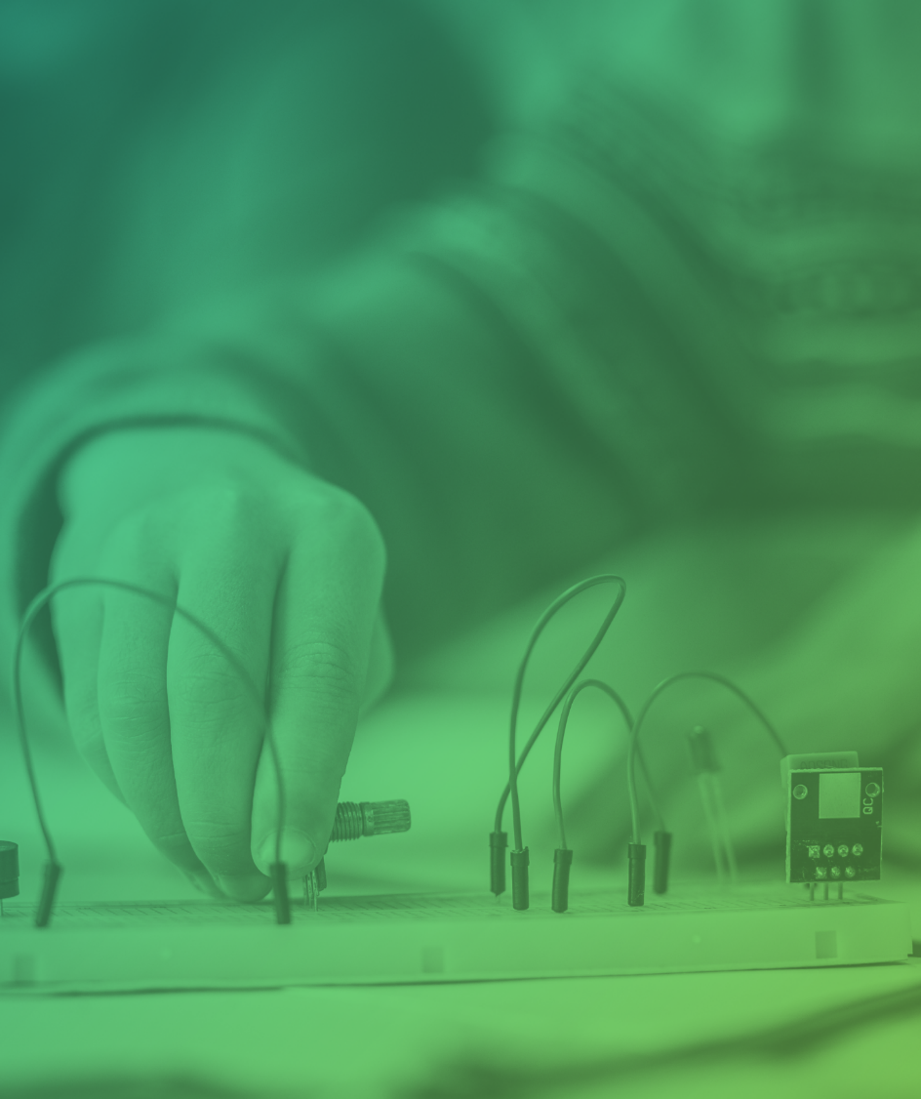
Thank you

